Slide 1
Lecture 01: Introduction to HTML and CSS
Taslim Arefin Khan
arefin612@gmail.com

Slide 2
Course Contents
All materials and lectures will be updated here https://goo.gl/fC0Nvt
Course contents
https://www.w3schools.com/html/
HTML and CSS design and build websites by Jon Duckett

Slide 3
What is HTML?
Hyper Text Markup Language
Standard markup language for creating web pages
HTML elements are represented by tags
Browsers do not display tags
HTML files end with .html/.htm extension
What is the difference between .html and .htm?

Slide 4
Editors
Notepad, NotePad++, Sublime text
Adobe Dreamweaver
Run/Open in a web browser

Slide 5
Elements and Tags
HTML element starts and ends with tags
<tagname>content… </tagname>
Tag names are NOT case sensitive
<p> and <P> are same
Must close a tag
<h1>….</h1>
<h1> is the start tag
</h1> is the end tag
Empty tags
<br />
<hr />

Slide 6
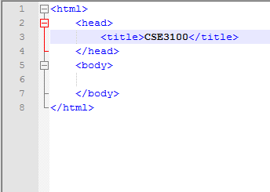
Basic Template

Slide 7
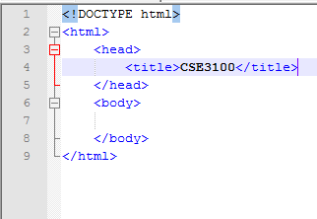
Basic Template 2: HTML5

Slide 8
Some Useful Elements
h1, h2, h3, h4, h5, h6
Anchor tag <a>..</a>
Image <img >
Line break <br />
Horizontal line <hr />
Paragraph <p>..</p>
Table <table></table>

Slide 9
Attributes
Attributes provide additional information
All HTML elements can have attributes
Attributes are specified with start tag
<p title=“my paragraph”></p>
title is an attribute

Slide 10
CSS
Cascading Style Sheet
Mainly used for styling web pages
Three ways to add CSS to HTML
Inline
Internal
External

Slide 11
CSS: Inline
Unique style to a single element
Uses style attribute
<h1 style=“color:blue;”></h1>

Slide 12
CSS: Internal
Defines style of an html page
Declared at the top of the page
Within <style> element
Inside <head> element

Slide 13
CSS: External
An external css file linked to the html file
Link using <link > element
Inside <head> element
File must have .css extension

Slide 14
div
Defines a section of an html page
Rectangular area defined in the html page
Also used to group a collection of elements

